Slide 1


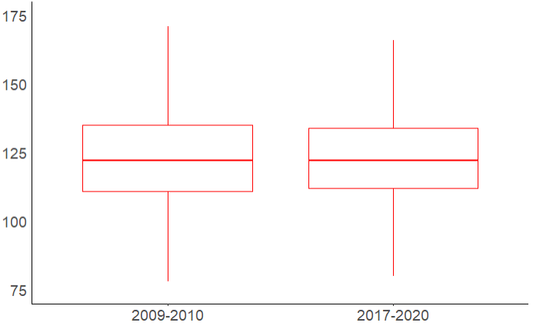
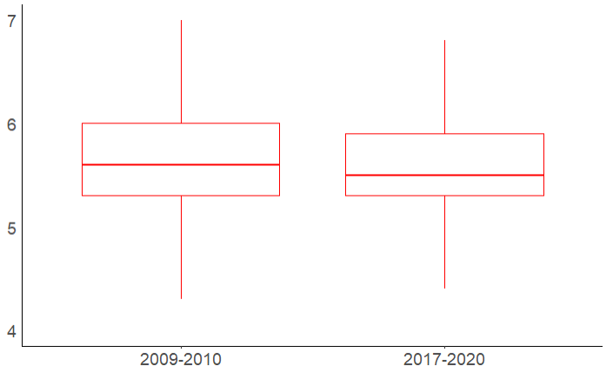
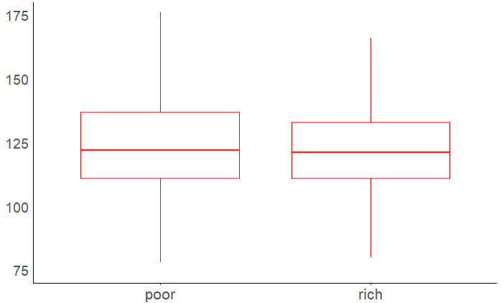
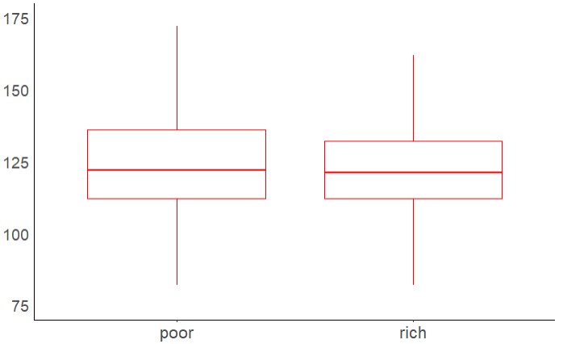
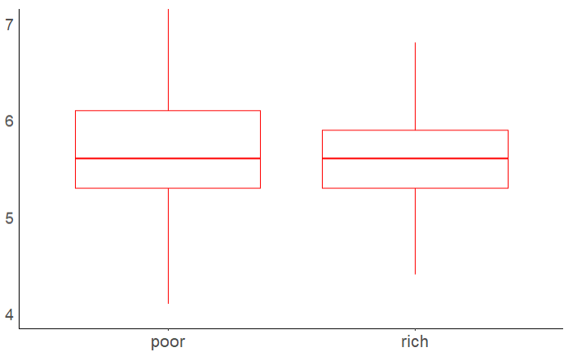
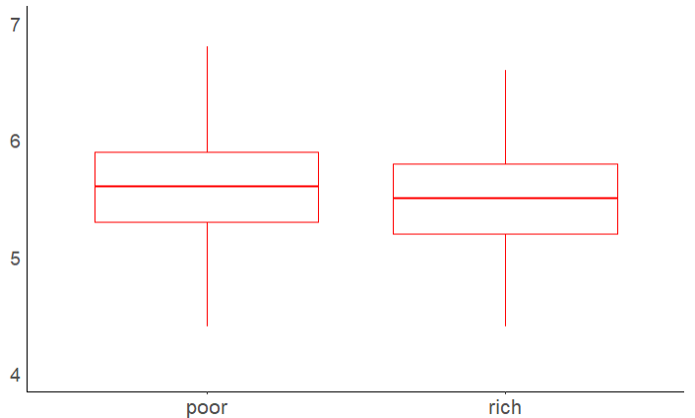
Background Literature Review
Exploring the Link Between Household Income and Cardiovascular Disease Factors in Adults: A 10 Year Analysis
Arham Salman¹, Sabrin Sefa¹, Moumita Chakraborty PhD¹, Neil Mehta PhD²
Department of Biostatistics and Data Science 2. Department of Epidemiology
Introduction
Results
Table 2. Linear model displaying blood pressure as an outcome of several predictors. Gender: Male = 1, Race: Mexican American = 1 *P<0.05, **P<0.01 and ***P<0.001.
Table 3. Linear model displaying HBA1C as an outcome of several predictors. Gender: Male = 1, Race: Mexican American = 1 *P<0.05, **P<0.01 and ***P<0.001.
Socioeconomic status (SES), including household income, plays a pivotal role in shaping health outcomes and access to healthcare resources.
The prevention and treatment of CVD have greatly benefited from advancements in medical science and healthcare. Despite the significant developments in cardiovascular medicine, concerns remain regarding potential disparities in the efficacy of these interventions across various population groups.
Our research examines the link between cardiovascular (CV) risk factors (blood pressure or BP and blood glucose) and income in 2009–2010 and 2017–2020, using national data (NHANES).
Literature Review
A B
Conclusion and Future Work
Numerous studies have documented differences in CVD risk factors across socioeconomic groups.
SEP (education attainment and household income) are larger for the socially and economically privileged group and minimized for racial and ethnic groups using data from (NHANES; 2005-06) included 4,773 adults ≤ 20 years. (Assari 2019)
In the socioeconomic gradient of diabetes-related mortality, the risk of death is strongly impacted by both income level and educational attainment using data from the National Health Interview Survey using 527,426 adults surveyed between 1900 and 2000. (Saydah 2010)
In the study with 44,986 adults using NHANES data from 1999-2016, there is a significant differences in CVD prevalence that were observed between the richest and poorest groups. (Abdallah 2020)
Other studies did not look into the relationship between household income and CVD factors using the same collection of sources, demographics, and recent time periods (2009–2010 and 2017–2020).
Household income influences disparities in Blood Pressure and Blood Glucose levels.
Main Findings:
There was a significant difference in both the BP levels over 10 years and its variation between the poor and rich in 2009-10.
There is also a significant difference in HBA1C percentage between the poor and rich in both time frames.
The social gradient for diabetes is rising, possibly due to new medical treatments favoring wealthier households over poorer ones.
Multivariate regression model results indicated that disparities still existed after controlling for age, gender, BMI and race suggesting Household income really does matter.
Future work:
Further analysis of household income and CVD factors should include qualitative research to understand people's perspectives and experiences related to their income, CVD, and healthcare access.
Take COVID-19 into consideration (confounding variable) as the pandemic distorted healthcare
Investigate the interaction between genomic and environmental variables in people from various SES backgrounds and their impact on the risk of CVD.
Figure 1: Systolic Blood Pressure & Glycohemoglobin comparison over 10 years with Wilcox t-test; A: 2009-10, B: 2017-20 ***P<0.001.
v
A B
Objectives
Figure 2: Systolic Blood Pressure comparison between Poor vs Rich income groups over 10 years with Wilcox t-test; A: 2009-10, B: 2017-20 *P<0.05.
To investigate the overall relationship between household income and CV disease risk factors (BP and blood glucose) in adults aged 25-79 years in 2009-2010 and 2017-2020.
Identify this relationship after adjusting for age groups, genders, and race/ethnicities and assess how they have changed over time
Methods
Acknowledgements and References
Data Source : NHANES, 2009-2010 and 2017-2020
Study Population & Size : ages 25-79; n = 9231; 2009-10 (n=3859), 2017-20 (n=5372)
CVD risk factors : Systolic Blood Pressure or BP (mm Hg); Blood Glucose (Hba1c)
Control factors: Obesity (BMI ≥ 25); Age (years); Gender (female/male); Race/ethnicity
Independent Variables: Income to poverty ratio (PIR); A PIR value of 1.0 or less indicates household income at or below the poverty level in relation to the federal poverty level.
Statistical software R; t-tests & boxplots for bivariate relationships between predictors and, multivariate linear regression for predicting each of the outcomes separately based on independent variables.
The project was supported by The University of Texas Medical Branch Summer Institute in Biostatistics and Data Science National Heart Lung and Blood Institute (NHLBI) grant #R25HL161715
A B
Assari S. Socioeconomic Determinants of Systolic Blood Pressure; Minorities' Diminished Returns. J Health Econ Dev. 2019 Spring;1(1):1-11. PMID: 31428747.
Saydah S, Lochner K. Socioeconomic status and risk of diabetes-related mortality in the U.S. Public Health Rep. 2010 May-Jun;125(3):377-88. doi: 10.1177/003335491012500306. PMID: 20433032; PMCID: PMC2848262.
Abdalla SM, Yu S, Galea S. Trends in Cardiovascular Disease Prevalence by Income Level in the United States. JAMA Netw Open. 2020 Sep 1;3(9):e2018150. doi: 10.1001/jamanetworkopen.2020.18150. PMID: 32975572; PMCID: PMC7519418.
The project was supported by The University of Texas Medical Branch Summer Institute in Biostatistics and Data Science National Heart Lung and Blood Institute (NHLBI) grant #R25HL161715
Figure 3: Glycohemoglobin Percentage comparison between Poor vs Rich income groups over 10 years with Wilcox t-test; A: 2009-10, B: 2017-20 ***P<0.001.
Table 1: Comparison of Blood Pressure and HBA1C in Poor and Rich Groups over time; A,B,C,D ***P<0.001.

